Slide 1


XV6 OPERATING SYSYTEM
CASE STUDY
Presented By : 20DCE019 – Yatharth Chauhan

Slide 2
What is XV6?
1
Let’s start with the first set of slides

Slide 3
How can one run XV6?
XV6 can be installed as a standalone OS (not recommended)
XV6 can run in an emulated environment (recommended)
QEMU is the emulator we use to run XV6
QEMU is a user program/system emulator
Examples:
Running Arm on your Home PC
Running Windows on Linux
Running XV6 on your Ubuntu

Slide 4
UNIX XV6
2

Slide 5
Case study: Unix V6
Early Unix OS for DEC PDP11
By Ken Thompson & Dennis Ritchie, 1975
From Bell labs;
1st version to be widely used outside Bell
Ancestor of all Unix flavors (Linux, *BSD, Solaris,…)
Much smaller
Written in C
Recognizable (shell, multiuser, files, directories, …)
Today’s Unix flavors have inherited many of the conceptual ideas, even though they added lots of stuff (e.g., graphics) and improved performance

Slide 6
Case study: Unix V6
1976 Commentary by Lions: a classic….
Despite its age
still considered excellent commentary on simple but high quality code
For many years, was the only Unix kernel documentation publicly available
v6 allowed classroom use of source code; v7 & onwards didn’t
Commonly held to be
one of the most copied books in computer science.
Reprinted in 1996
still sold

Slide 7
Case study: Unix V6
xv6 is an MIT reimplementation of Unix v6
Runs on x86 (if you insist)
We’ll run it on top of QEMU
Even smaller than v6
Preserves basic structure (processes, files, pipes, etc.)
Runs on multicores
Got paging in 2011 ☺
To “get it”, you’ll need to read every line in the source code
But it’s really isn’t that hard
The commentary book on the webpage will greatly help

Slide 8
Case study: Unix V6
First half of course
Each lecture studies source code of one xv6 part
Should help in HW assignments (or vise versa)
About half-way the term
You’ll understand the source code for one well-designed OS for an Intel-based machine
2nd half
Covers OS concepts invented after Unix v6
We’ll typically discuss research papers targeting these concepts
No tutorials from that point…

Slide 9
XV6 – Why?
3

Slide 10
XV6 – Why?
Q: why study an aging OS?
Instead of, say, Linux, or Windows, or FreeBSD, or Solaris, …
A1: it’s big enough
To illustrate basic OS design & implementation
Yet is far smaller => much easier to understand
A2: it’s similar enough
To those other modern OSes
Once you've explored xv6, you’ll find your way inside kernels such as Linux
A3: as noted, it’ll help you
To build your own (J)OS

Slide 11
OS - Engineering
JOS
Occupies a very different point in the design & implementation space from xv6
Types of OSes
Micro kernel
QNX, L4, Minix
Monolithic kernel
xv6, Unix family (Linux, FreeBSD, NetBSD, OpenBSD, Solaris/SunOS, AIX, HPUX, IRIX, Darwin), Windows family
Actually, most are nowadays hybrid
Exokernel
JOS

Slide 12
Implementing virtual memory in XV6
4
From the perspective of the boot process

Slide 13
XV6 address space
xv6 enforces memory address space isolation
No process can write on another’s space or the kernel’s
xv6 does memory multiplexing
every process’s memory starts at 0 & (appears) contiguous
C, as well as the linker, expect contiguity
xv6 does simple page-table tricks
Mapping the same memory (kernel’s) in several address spaces
Mapping the same memory (kernel’s) more than once in one address space
Kernel can access user pages using user virtual addresses (0…)
Kernel can also access user pages through kernel’s “physical view” of memory
Guarding a user stack with an unmapped page

Slide 14
XV6 address space
x86 defines three kinds of memory addresses
Virtual (used by program), which is transformed to
Linear (accounting for segments), which is transformed to
Physical (actual DRAM address)
xv6 nearly doesn’t use segments
All their bases set to 0 (and their limits to the max)
virtual address = linear address
Henceforth we’ll use only the term “virtual”

Slide 15
Paging in a nutshell
Virtual address (we assume 32bit space & 4KB pages):
Given a process to run, set cr3 = pgdir (“page directory”)
Accessing pgdir[pdx], we find this PDE (page directory entry)
Flags (bits): PTE_P (present), PTE_W (write) , PTE_U (user)
20bits are enough, as we count pages of the size 2^12 (=4KB)
The “page table” pgtab = pgdir[pdx] & 0x ffff f000
An actual physical address
Accessing pgtab[ptx], we find this PTE (page table entry)
Target physical address =
(pgtab[ptx] & 0x ffff f000) | (virt_adrs & 0x 0000 0fff)
page offset (12bit) | ptx (10bit) | pdx (10bit)
flags (12bit) | physical address (20bit)
flags (12bit) | physical address (20bit)

Slide 16
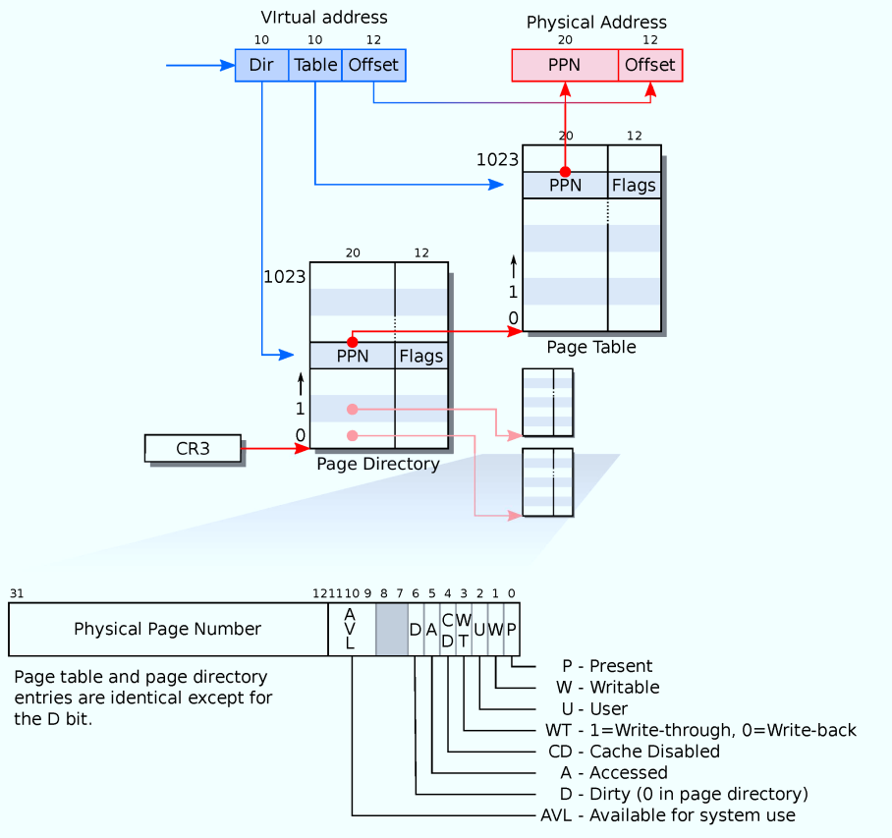
Paging HW

Slide 17
THANKS!
Any questions?
You can find me at:
Email: yatharthchauhan2024@gmail.com

